Slide 1

The comment letters are in!
IFRS 4 Phase II
Francesco Nagari
Deloitte Global IFRS Insurance Lead Partner
31 October 2013

Slide 2
Agenda
  Background
  Deloitte response on five key topics re-exposed
  The likely effects of the Standard

Slide 3
Background
What have you been reading in the past four months?
  The IASB re-exposed in the revised exposure draft (revised ED) changes in five key areas without seeking further comments on other topics.
  These 5 areas were:
      Adjusting the unearned profit from insurance contracts -‘Unlocking of contractual service margin (CSM)’
      Presentation of interest expense between profit or loss and the other comprehensive income (‘OCI’) - ‘the OCI solution’
      Accounting for contracts that specify a link to the returns on underlying items that the entity is required to hold – the ‘Mirroring Approach’ for participating contracts
      Presentation of insurance contract revenue and expenses -‘Earned premium approach’
      Effective date and transition – Retrospective application with some practical expedients

Slide 4
The CSM unlocking as proposed in the revised ED
Explicit unearned profit and its interaction with fulfilment cash flows
  Initial recognition – the CSM is calibrated to the fulfilment cash flows (including risk adjustment) and it represents the unearned profit of the insurance contract
  Subsequent measurement – CSM is released to earn profit over the coverage period and adjusted only for changes in the expected cash flows related to future coverage and other future services. All other changes to be recognised in profit or loss.
  The CSM cannot be negative
Unlock increasing CSM
If favourable changes, no upper limit on CSM unlocking
If unfavourable changes, impact in excess of carrying amount of CSM as at the date of change is recognised immediately in P+L
Adjust CSM, until exhausted

Slide 5
Deloitte Comment Letter proposal on CSM
A number of material areas need to be improved to reflect portfolio economics
Welcome unlocking
Better reflection of CSM’s nature as an unearned profit
Propose to modify
Clarification that CSM cannot be negative
To extend CSM earning period beyond coverage
To adjust CSM for prospective changes in risk adjustment (RA)
To not restrict CSM unlocking for changes in future CFs (other than for changes in discount rate when ‘OCI solution’ is used)

Slide 6
Deloitte CSM unlocking proposals in more detail
  Provision of service does not stop at coverage
  Release CSM over combined coverage and claims handling period
  Establish CSM to be released post coverage in a PAA unexpired coverage liability
  Unearned profit should reflect changes in risk of future cash flows and P+L should reflect expiry of risk in the period
  Unlock CSM for prospective changes in RA from changes in assumptions
  Release in the period change in RA of outstanding contracts keeping assumptions the same as at the beginning of the period
  Unearned profit measure should reflect changes in all future cash flows (except for discount rate changes given the ‘OCI solution’)
  Unlock CSM for changes in estimates of future CFs depending on investment returns of underlying items is consistent with treatment of all other changes in future cash flows

Slide 7
The OCI solution
Dealing with interest rate fluctuations and insurers’ performance
  Objective of the OCI solution
  Provide information that faithfully represents the financial performance by segregating the effects of underwriting performance from the effects of changes in discount rates
  This approach recognises that an insurance liability is not liquid, therefore the impact of interest rate fluctuations should not be reflected in profit or loss as these will unwind
  IFRS 9 will introduce a new category ‘fair value through OCI’ for bonds
  Proposed accounting treatment
  Changes in insurance liability arising from changes in discount rate presented in OCI. Interest expense recognised in profit or loss determined using the discount rate that applied at the date that the insurance liability was initially recognised
  For participating contracts the “mirroring approach” has precedence over OCI solution
  Derivatives not allowed to be accounted for under OCI solution in IFRS 9 or revised ED

Slide 8
The OCI solution
Some issues and practical considerations
  Issues
  Fair Value through OCI will be available for debt instruments, but accounting mismatches may not be entirely eliminated, for example:
    Assets at Amortised Cost or Fair Value through Profit or Loss
    Where a derivative is used to manage a gap between the duration of the insurance liability and the backing assets, changes in the fair value of the derivative are recognised in profit or loss
  Impacts on post claim liabilities where Premium Allocation Approach (PAA) is applied
  Practical considerations
  Will need to maintain two sets of balance sheet data: one at current interest rates and one at the original locked-in rate. It will be necessary to determine the specific assets that back the insurance liability to prevent an accounting mismatch
  Tracking insurance contract liabilities and backing assets, and changes in interest rates, is potentially demanding
IFRS 4 Phase II Comment letter – Webcast (October 2013)

Slide 9
Deloitte Comment Letter on the OCI solution
Support development in conjunction with IFRS 9
Reduction in accounting mismatches
Propose to modify
Permit designation of insurance contracts – no mandatory OCI
Unconstrained ability to adopt FV option on assets
Failing this, allow presenting in profit or loss changes in insurance contracts accumulated OCI reserve to the extent that they represent gains/losses attributable to the hedged risk
IFRS 4 Phase II Comment letter – Webcast (October 2013)

Slide 10
Deloitte OCI solution proposals in more detail
  Presentation of part of the interest expense through OCI
  Does not fully capture the nuances of asset-liability management
  Results will leave a substantial number of accounting mismatches
  Interaction with financial instruments
  The OCI solution may not reduce significant accounting mismatches, even when the cash flows from assets and liabilities are economically matched, due to the mixed financial asset measurement model combined with a mandatory OCI solution on insurance liabilities
  A non-mandatory OCI solution
  OCI solution depends to a significant extent on the ALM strategy selected
  The designation of which insurance contracts will use the OCI solution and which will reflect all changes in discount rate through profit or loss should be introduced
  Unconstrained ability to adopt a fair value option is critical to ensure symmetry of application to financial instruments and insurance contracts

Slide 11
    Participating contracts ‘mirroring approach’
  Need to ‘decompose’ the different sets of cash flows in a contract to identify those cash flows that vary directly with the underlying assets
  Illustrative example
  5-year contract with a single premium of CU2,000 received at inception.
  Surrender and maturity values are 90 per cent of the value of a specified pool of assets held by the company where his premium was invested
  Death before the end of 5 years triggers a fixed death benefit of CU4,000
  Maturity value is guaranteed to be at least CU2,000
CF2: 90% of the value of underlying assets
CF3: Value of the option to maturity
CF1: death benefit of CU 4,000
BBA with OCI and unlocking
Use “items” accounting value
BBA with all changes in P+L

Slide 12
Deloitte comment on approach to ‘mirroring approach’
Agree that economically matched asset-liability cash flows should be faithfully represented
Propose to modify
Abandon the mirroring approach decomposition
Replace it with a BBA valuation modified in two areas:
Discount rate should mirror the “book yield” of the underlying items; and
The CSM should be unlocked with inclusion of expected returns from underlying items not captured in the liability (insurer’s share)

Slide 13
Deloitte ‘mirroring approach’ proposals in more detail
  Separate model is complex and unrepresentative of a contract as a bundle of different cash flows
  Scope is not well defined (paragraph 33)
  Analysis of CFs into 3 types is complex and artificial resulting in different measurement and presentation for each
  Results are inconsistent with economic design and pricing of embedded derivative features
  ‘Mirroring’ produces misleading results if underlying items are not at FV
  No guidance how to apply ‘mirroring’ if underlying is a pool of insurance contracts or results of entity itself

Slide 14
Deloitte ‘mirroring approach’ proposals in more detail (cont.)
  Propose to account for all participating contracts using the same accounting model as all other insurance contracts with two key modifications
Amendment to discount rate
  Accrete interest on directly linked cash flows using the yield generated by those underlying items limited to their expected duration.
  For cash flows beyond duration of underlying items estimate discount rate using the general provisions of the revised ED.
  The difference between the rate estimated above and the current rate in the B/S would be recognised in OCI if the entity elected to use ‘OCI solution’
Unlocking of CSM for the returns on underlying items attributable to the insurer
  Propose to adjust the CSM for the returns on underlying items attributable to equity holders until the distribution to policyholders is made
  This would reflect the fact that insurer provides a service to current and future policyholder (B66(k)) by allowing them participation in the underlying items
  The insurer’s obligation to policyholders is not fulfilled until the distribution is made

Slide 15
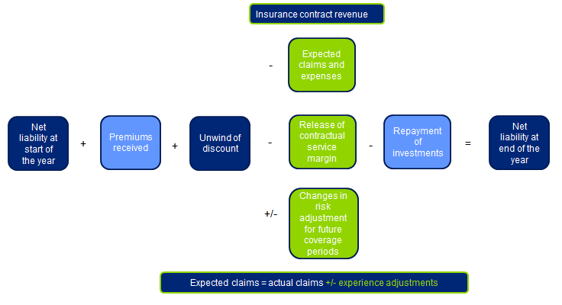
Presentation of revenue and expenses
The reengineering of the balance sheet movements to produce a new revenue
Liability for remaining coverage

Slide 16
Deloitte Comment Letter on presentation of revenue and expenses
Propose to modify
New revenue metric is not the most faithful representation of long duration contracts
New insurance revenue does not appear to be the volume information requested by investors
Recommend the presentation of the summarised margin as presented in the 2010 ED

Slide 17
Deloitte presentation of revenue and expenses proposals in more detail
  Concerns about the proposals in the 2013 ED
  The proposed new revenue metric would not be the most faithful representation of the contribution that long duration contracts make to the financial performance as it is in conflict with the portfolio of contacts as a unit of account
  The desire to develop a common presentation requirement should be measured against the different characteristics of different types of insurance contracts portfolios
  We believe that the Board should accept the co-existence of two different presentation requirements for short and long coverage duration contracts
  The new revenue does not appear to provide the volume information requested by investors
  Summarised margin approach
  Present the the summarised margin in the statement of comprehensive income appears to be preferable with PAA presentation as a policy option
  We support disclosing the effect of the insurance contracts on initial recognition on the amounts that are recognised in the statement of financial position. This would show separately the effect on the expected present value of future cash inflows, outflows, risk adjustment and CSM.

Slide 18
Approach to transition
Retrospective application with some practical expedients
  Full retrospective application with a set of pragmatic measures
  Measure the insurance contract at the sum of the fulfilment cash flows in accordance with the standard and an estimate of the remaining CSM
  Estimate the liability, excluding any losses on the date of initial recognition and any changes in the estimates between the date of initial recognition and the beginning of the earliest period presented that were immediately recognised in profit or loss
  Determine, for the purpose of measuring interest expense to be recognised in profit or loss, the discount rates that applied when the contracts were initially recognised
  Estimate the discount rates that applied at the date of initial recognition using an observable yield curve that approximates to that estimated in accordance with the Standard. If such a curve does not exist, estimate the discount rates by determining an average spread between an observable curve and the curve calculated in accordance with the Standard, and apply that spread to that observable curve
  Do not need to undertake exhaustive efforts to obtain objective information, but shall take into account all objective information that is reasonable available

Slide 19
Approach to transition
Re-designation of financial assets – the interaction with IFRS 9
  Re-designation of financial assets
  At the beginning of the earliest period it is permitted but not required to re-designate a financial asset at FVTPL if this would significantly reduce an accounting mismatch.
  If IFRS 9 has previously been applied, designate an investment in an equity instrument at FVOCI or revoke a previous election to use FVOCI
  Required to revoke previous designations at FVTPL if the initial application of the Standard eliminates the accounting mismatch

Slide 20
Deloitte comment on approach to transition
Agree that exhaustive efforts not required
Full retrospective approach is the most appropriate and accurate method
Propose to modify
Consider FASB proposal to measure CSM by aggregating contracts at the portfolio level
If this is impracticable, need not undertake exhaustive efforts to obtain objective information
Insurance contracts based on fulfilment cash flows
Encourage effective dates of insurance contracts Standard and IFRS 9 to be aligned
A period of 3 years is sufficient to allow implementation
Failing this, an option to reclassify financial assets
An unconstrained ability for an irrevocable option to adopt fair value on assets

Slide 21
      Deloitte approach to transition proposals in more detail
  Alignment of the measurement of financial assets and insurance liabilities
  We encourage the alignment of the effective date of the new IFRS on insurance contracts and IFRS 9 (as amended) to be aligned, with early application permitted
  If not, include option to reclassify financial assets to alleviate concerns about classifying investments without knowing accounting requirements for insurance liabilities
  An unconstrained ability to adopt a fair value option is critical to address accounting mismatches across different asset-liability management strategies
  Option designated at initial recognition and be irrevocable, therefore little risk for this to be subject to abuse, and the reason for choosing the option should be disclosed

Slide 22
      The likely effects of a Standard for insurance contracts
      Balancing the costs with the benefits
  Global IFRS Insurance Survey 2013
  The Economist Intelligence Unit surveyed 300 insurers to investigate their views on the proposed IFRS for insurance contracts
  The waiting is over
  The IASB has given a clear indication that the mandatory effective dates for IFRS 4 and IFRS 9 are set within a narrow range
  This has removed years of uncertainty for the industry and has given the green light to insurers that they can begin their preparations
  59% have started IFRS projects, and 85% believe they will have completed the work within the expected three year timeline proposed by the IASB
  Cost is the key
  Since the adoption of the new standards rewrites the rules for financial reporting for the industry, the transition will be complex
  Worries over the cost of implementation dislodge previous concerns over uncertainty
  Insurers predict the average budget for the changes required as a result of implementing the Standards will be between $25m and $50m

Slide 23


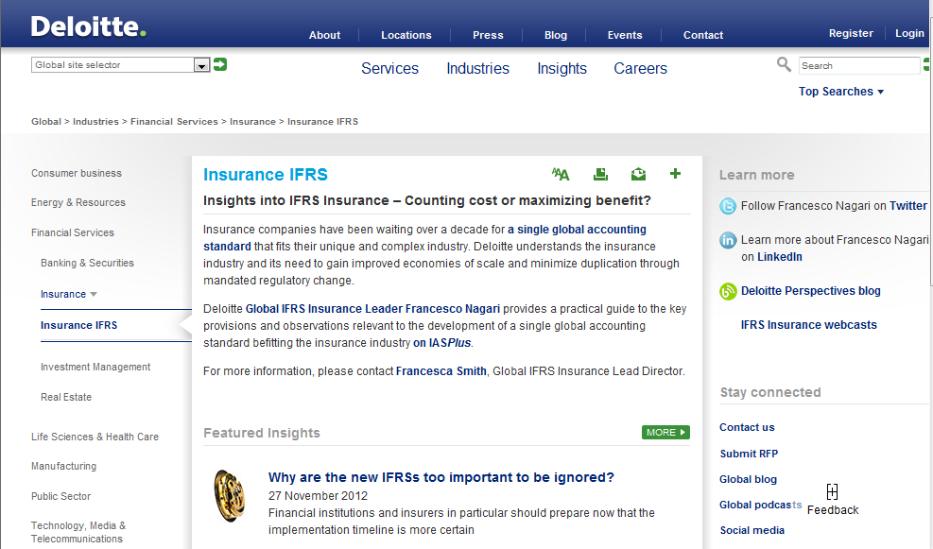
Contact details
Francesco Nagari
Deloitte Global IFRS Insurance Lead Partner
+44 20 7303 8375
fnagari@deloitte.co.uk
@Nagarif
Deloitte Insights into IFRS Insurance (i2ii)
www.deloitte.com/i2ii
Insurance Centre of Excellence:
insurancecentreofexc@deloitte.co.uk
IFRS 4 Phase II Comment letter – Webcast (October 2013)

Slide 24

This seminar and the accompanying hand-outs cover topics only in general terms and are intended to give a wide audience an outline understanding of issues relating to accounting applicable to entities in the insurance sector, and therefore cannot be relied on to cover specific situations; applications of the principles set out will depend on the particular circumstances involved. Furthermore, responses given in the seminar to questions are based on only an outline understanding of the facts and circumstances of the cases and therefore do not form an appropriate substitute for considered specific advice tailored to your circumstances. We recommend that you obtain professional advice before acting or refraining from acting on any of its contents. We would be pleased to advise you on the application of the principles demonstrated at the seminar and other matters to your specific circumstances but in the absence of such specific advice cannot be responsible or liable.
Deloitte LLP is a limited liability partnership registered in England and Wales with registered number OC303675 and its registered office at 2 New Street Square, London EC4A 3BZ, United Kingdom. Deloitte LLP is the United Kingdom member firm of Deloitte Touche Tohmatsu ('DTT'), a Swiss Verein, whose member firms are legally separate and independent entities. Please see www.deloitte.co.uk\about for a detailed description of the legal structure of DTT and its member firms.
© 2013 Deloitte LLP.
Notes:
23

